Slide 1
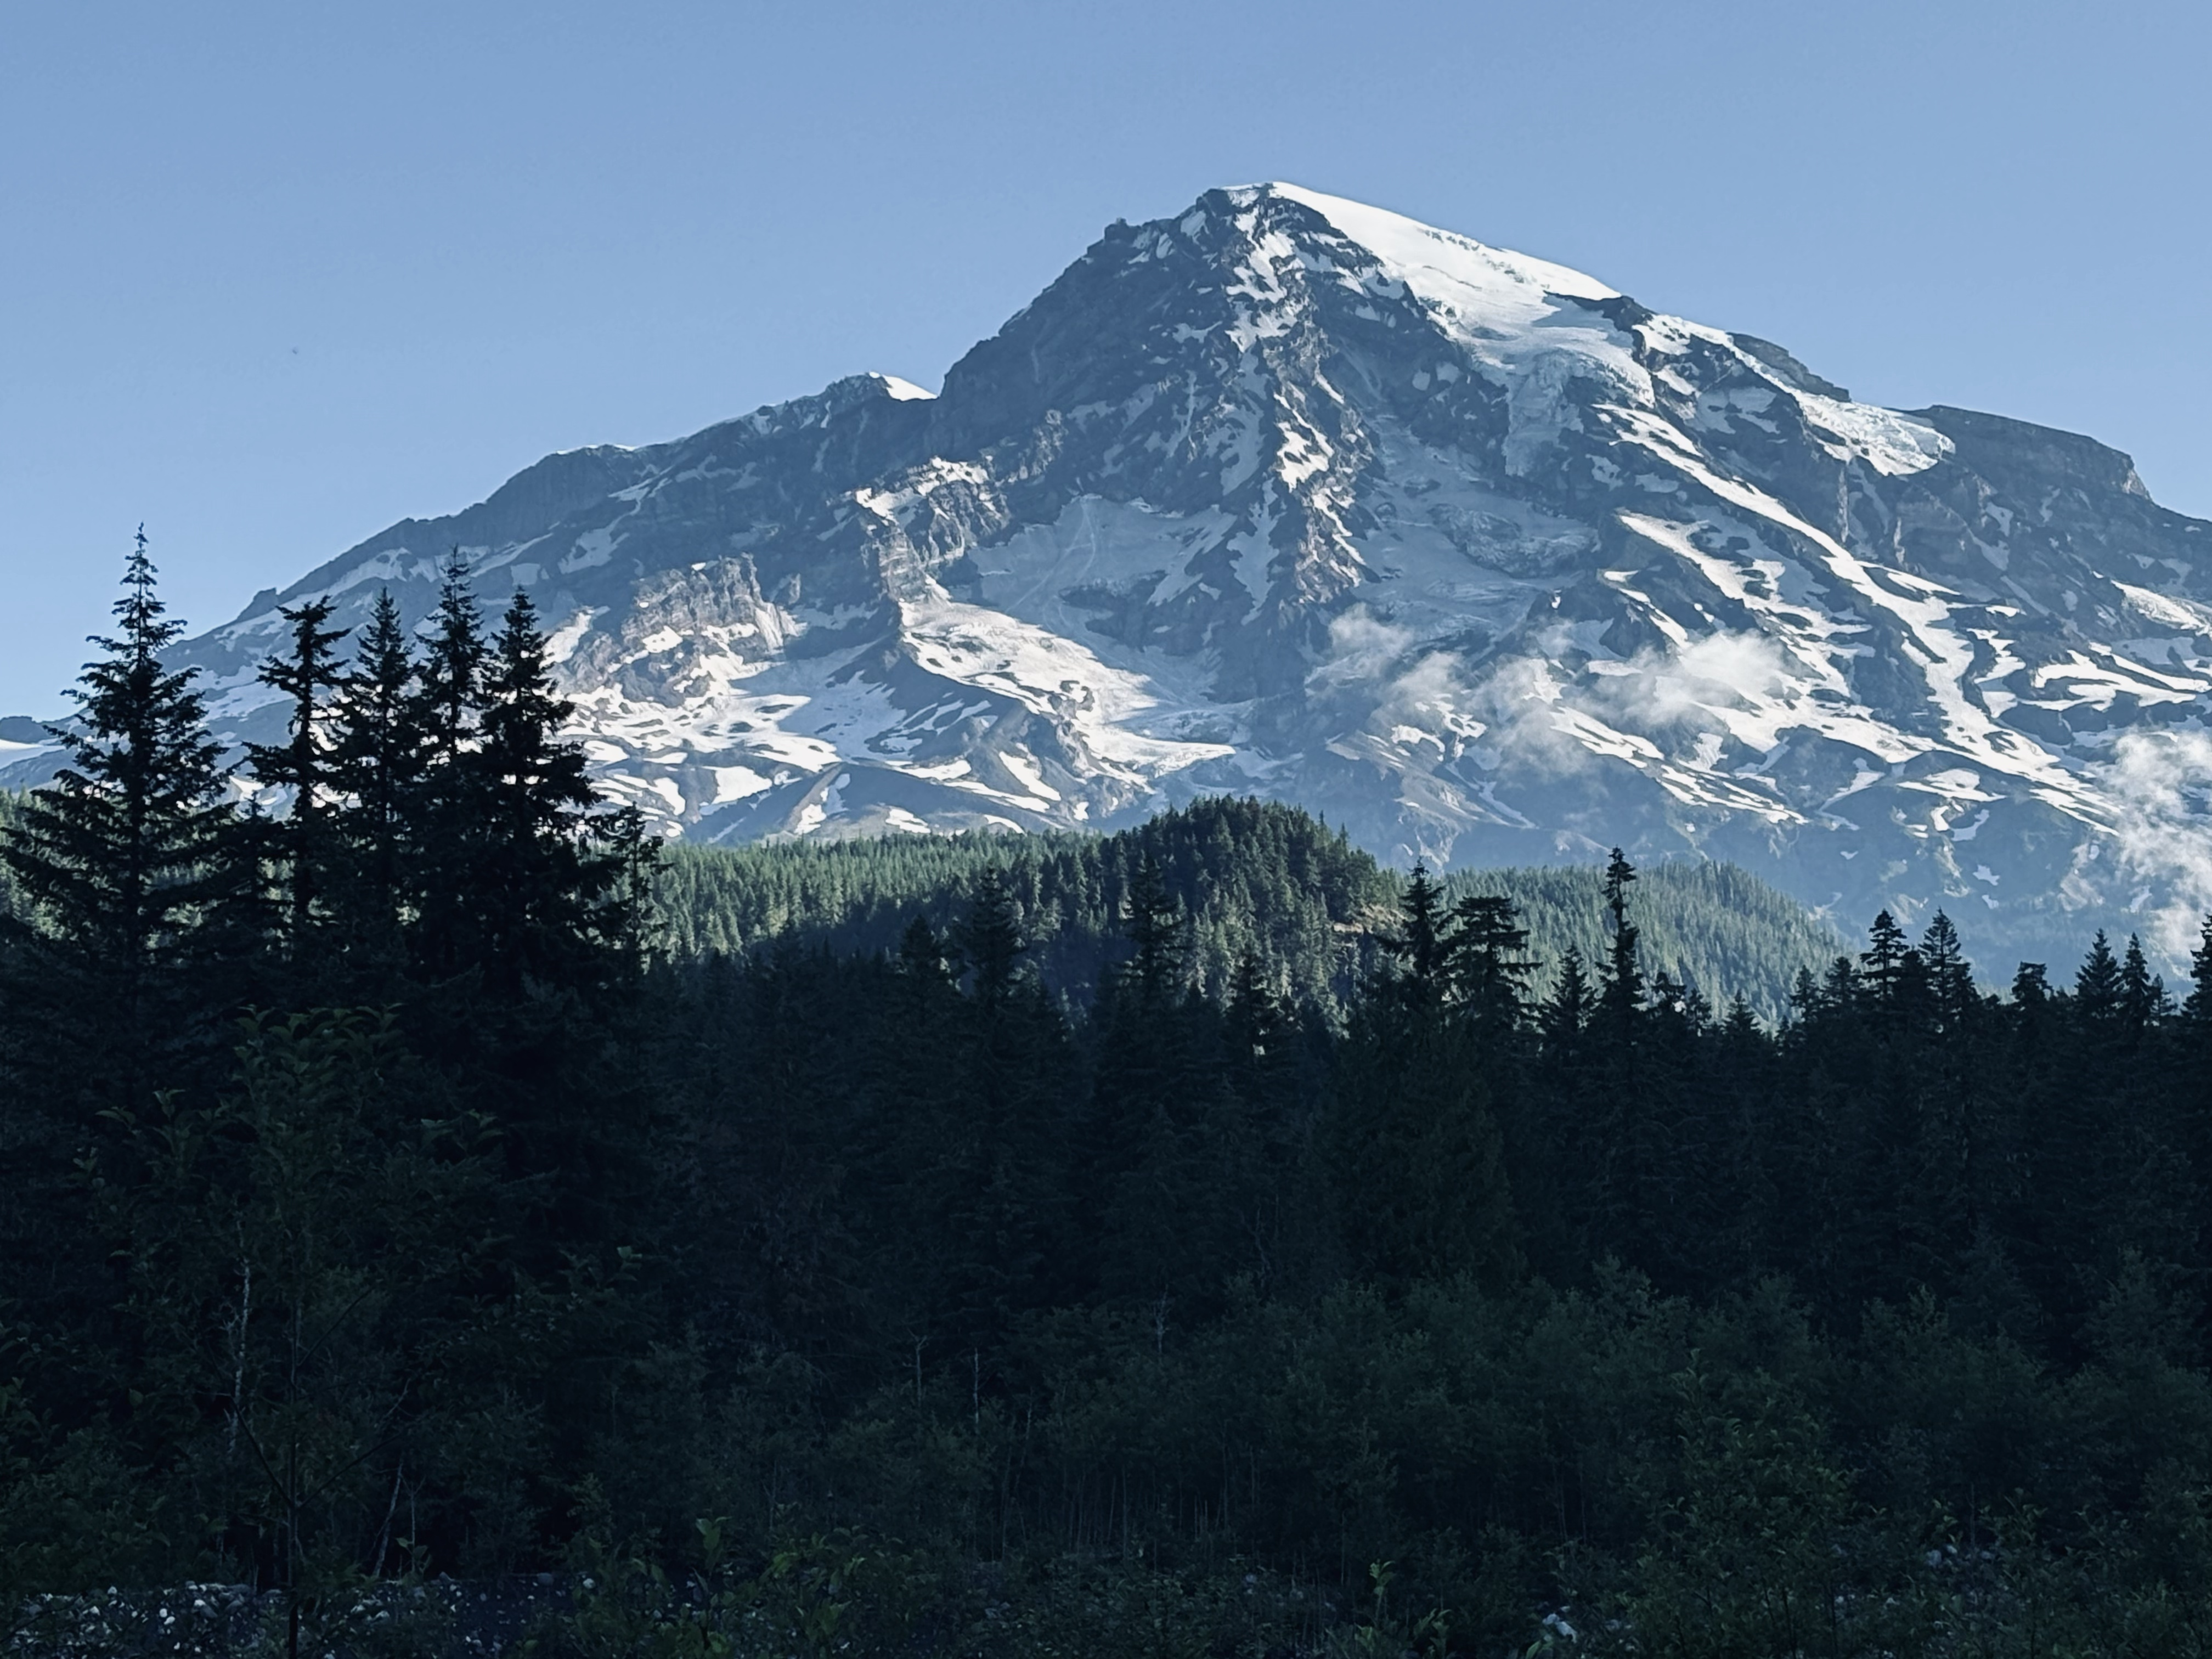


Life on a Budget: Reproduction-growth Trade-Offs in Masting Trees
Xiaomao Wang
Temporal Ecology Lab
Faculty of Forestry, University of British Columbia
Nov 21 2025
Notes:
Hi everyone! My name is Mao, and I’m a PhD student in Lizzie’s lab. I really wish I could be there in person today, but because of my visa issue, I couldn’t make it. So I am here, remotely, doing my best with the resources I’ve got — just like the trees I’m going to talk about.

Slide 2
Notes:
In 2023, the squirrels in Victoria are extra busy. The garry oaks in this region seems to produce river of acorns in all the driveway in the city. People complaining the sound of falling acorns like machine guns pelting the roof. This is what people usually call a mast year. So what’ the definition of masting? When we talk about masting, we’re not just describing trees that produce a lot of seeds — we’re describing a specific pattern of reproduction. Masting is a reproductive strategy that occurs at the population level, characterized by high variability in reproduction from year to year. It has four common characteristics: interannual variation (large year-to-year fluctuations) , synchrony (extended to population level), temporal autocorrelation (mast year is usually followed by non-masting year), and frequency (it can happen regular like every 2-3 years or more irregular like 3-7 years). Masting is very important because it is the key process driving forest regeneration, wildlife population dynamics. Understanding why and when trees mast is crucial for predicting forest dynamics in the long term.

Slide 3
Notes:
The puzzle: why do trees mast? People have many debates on this and have come up with many hypotheses, the most famous one is predator satiation, tree mast to overwhelms seed predators in mast year, to ensure some seeds will survive. Pollination coupling, synchrony enhances pollination success, resource matching, or environmental cues. Multiple mechanisms can interact and the reasons for masting for different species can be different.

Slide 4
Notes:
. The physiological basis: Resource allocation and trade-offs (3–4 min)
Explain that masting is fundamentally about how trees allocate limited resources between growth, storage, and reproduction.
Discuss key ideas:
Carbon and nutrient storage as prerequisites for mast events.
Trade-offs: Reproductive investment may come at the cost of growth or defense.
These trade-offs vary among species, environments, and years.
Highlight why this is important:
Provides mechanistic insight into how masting works.
Has implications for forest carbon balance and productivity.
Possible figure: schematic of tree carbon allocation (growth vs. reproduction vs. storage).

Slide 5
Notes:
Environmental context: Climate drivers of masting (2–3 min)
Masting is strongly influenced by climate variability:
Temperature and precipitation patterns can act as cues or constraints.
Shifts in snowpack, drought frequency, or growing season length may disrupt synchrony.
Discuss emerging evidence:
Warming trends can alter the frequency, intensity, or timing of masting.
Regional differences in climate sensitivity across elevation or species.
Tie to your study system (e.g., Mount Rainier):
“Mt. Rainier’s steep climate gradients provide a natural laboratory for studying how changing environmental conditions influence seed production.”

Slide 6
Notes:
5. Integrating across scales: From traits to ecosystem impacts (2–3 min)
Discuss the importance of connecting individual-level traits (storage capacity, reproductive strategy) to population-level patterns (synchrony, variability).
Highlight how masting affects:
Forest regeneration (seedling establishment success)
Animal populations (seed consumers, dispersers)
Ecosystem fluxes (carbon and nutrient cycles)
Present your overarching conceptual framework:
“By linking tree physiology, life-history traits, and climate variability, we can better understand and predict masting behavior under environmental change.”

Slide 7
Notes:
6. Looking forward: Why this matters (1–2 min)
Big-picture implications:
Predicting forest regeneration under climate change.
Managing wildlife populations and seed resources.
Anticipating forest productivity and carbon cycling shifts.
Summarize your motivation:
“Masting is a spectacular natural phenomenon, but it’s also a window into how trees make allocation decisions — and how those decisions shape forests in a changing world.”

Slide 8




Masting
Masting year
Masting year + 1
Notes:
I’m sure y’all are familiar with masting. Masting is a reproductive strategy that occurs at the population level, characterized by high variability in reproduction from year to year.
It’s thought to help reduce seed predation by overwhelming predators in mast years — so even though predators get a feast, plenty of seeds still survive. In low-seed years, predator populations can’t build up, which helps improve long-term regeneration success. Like in this cartoon: in a mast year, everyone’s happy — and some seeds still make it!

Slide 9

Resources allocation
Defence
Growth
Reproduction
Storage
Notes:
So why does masting happen?
If producing more seeds improves regeneration, why don’t trees just produce a lot every year?
The main reason is limited resources. Trees can only acquire so much carbon, water, and nutrients each year — and they have to divide those resources among several different life processes. Broadly speaking, we can group these into four categories: defence, growth, reproduction and storage. Defense, like producing chemical compounds to deter herbivores or pathogens, usually uses a smaller share of resources and is often triggered only by stress.
Storage is important when thinking about building up energy reserves, but it’s not always a big allocation in a given year especially when the resource itself is limited for other more critical processes.
That leaves growth and reproduction, which are typically the most resource-demanding processes and the ones that most directly influence a tree’s long-term survival and success. Then we can ask a follow up question, how is resource split to these two processes?

Slide 10
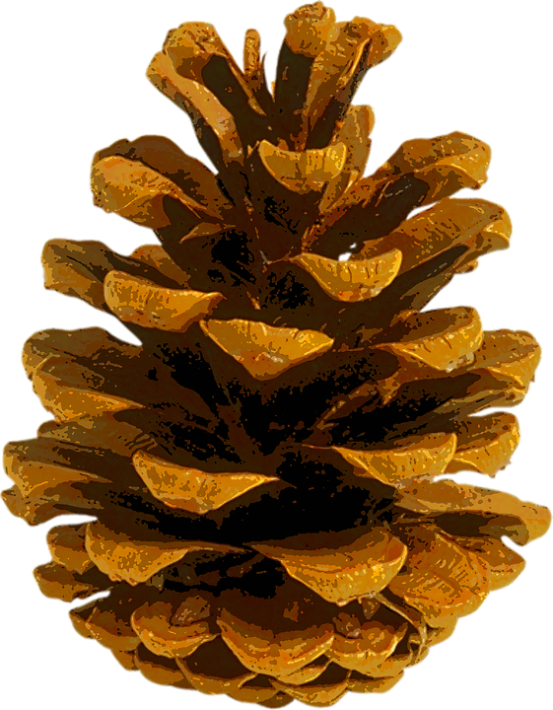
Resources allocation
+
Growth
+
Reproduction
Notes:
First, let’s imagine a tree that splits its resources equally between growth and reproduction every year.
In a poor year, when there are not many resources are available. We ended up not having enough resources for both growth and reproduction, we will only see very little in growth and very few seeds.

Slide 11
Resources allocation
++
Growth
++
Reproduction
Notes:
In a good year, the tree has more resources available to support more growth and more reproduction.
This model assumes resources going to growth and reproduction equally— just simply resource matching based on what's available. In this context, masting happens when there are lots of resources available, and we should be able to observe lots of growth at the same time when masting happens.

Slide 12
Growth-reproduction trade-off
+
Growth
++
Reproduction
Notes:
But there's another possibility — especially when we consider the masting.
Instead of equal resources allocated to both processes, the tree might shift priorities: in a more productive year, like mast years, more resources goes to reproduction at the expense of growth.
So when trees invest heavily in reproduction, we see reduced growth — suggesting a trade-off, not just resource matching.

Slide 13
Growth-reproduction trade-off
Growth
++
+
Reproduction
Notes:
And more growth is only observed when trees have fewer seeds, for example the years after a masting event. And this is called growth-reproduction trade-off, which we would expect to see in the context of masting event.

Slide 14





General reproductive cycle
Reproductive organs development
Pollination
Fertilization
Maturation
Dispersal
Notes:
So what controls how trees divide resources between growth and reproduction?
Let’s look at the reproductive cycle in trees. It includes stages like the development of reproductive organs — pollen and seed cones for conifers, or flowering buds in angiosperms.
In many temperate species, these processes start in the fall of the year before seed development. Then comes pollination in spring, followed by fertilization, then seed maturation, and finally seed dispersal.
All of these stages must succeed for a successful seed production to occur — and they’re all highly sensitive to environmental conditions.

Slide 15

Environmental conditions
‘Positive’ environmental events (environmental cues)
‘Negative’ environmental events (environmental vetos)
More seed (masting)
More growth (non-masting)
Trade-offs help to maximize plants’ fitness when resources are limited
Notes:
Some environmental conditions favor reproduction, and we call them environmental cues. For example, a warm, dry spring can enhance pollination and trigger a reproductive response — more resources go into seeds, leading to a mast year.
Other more negative events act as vetoes — like a late frost, which can damage flowers or developing seeds. In those years, trees may shift resources back to growth instead.
So the environment doesn’t just influence how much resource is available — it affects where those resources go.

Slide 16
Climate change
Wait, am I the only one get excited ??
Changes of environmental cues
Disruption of synchrony
Uncertainties of resources allocation
Notes:
Because masting depends on environmental cues and vetoes, climate change could disrupt this balance in several ways.
First, cues like warm, dry springs may become more frequent or less predictable, which could shift the timing or frequency of reproduction. But if these cues are followed by veto events — like late frosts or drought — seed development could fail, making reproductive investment less successful.
Second, individual trees may start responding differently to changing conditions because of intraspecific variation. That loss of synchrony across the population will weaken the advantage of masting, since predator satiation only works when many trees reproduce at the same time.
Finally, climate change could alter resource availability itself — through changes in temperature, and soil moisture — affecting how much trees can allocate to growth or reproduction in the first place.
All of this makes it harder to detect clear trade-offs and may shift how — or even whether — trees mast in the future.

Slide 17
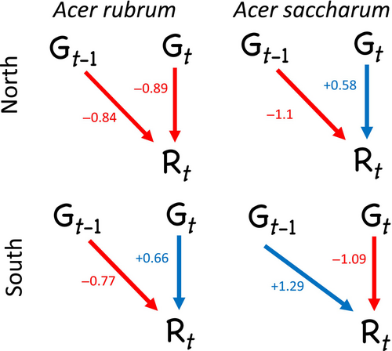
Previous studies
40% no trade-off; 40% trade-off; 20% climate dependent
Climate is very critical, the reproductive cycle is important
Vincent, C., & Ibáñez, I., Ecosphere, 2024
Notes:
There are about 15 published paper trying to look for if there’s a trade-off between growth and reproduction regarding masting. There are many studies on oak trees specifically. When we look at the result, it’s kind of a mixed picture.
About 40% of studies find no significant trade-off. Another 40% states clear evidence for a trade-off, and around 20% suggest that the relationship depends on climate independently, and it may disappear when remove climate effects.
For example, a recent study on two maple species at different latitudes found that the relationship between growth and reproduction changed depending on latitude, and both their growth and reproduction responded to climatic signals differently.
They also looked at growth in the year before a mast year — since reproductive development starts earlier — showing how important it is to understand the timing of resource allocation shifts.

Slide 18
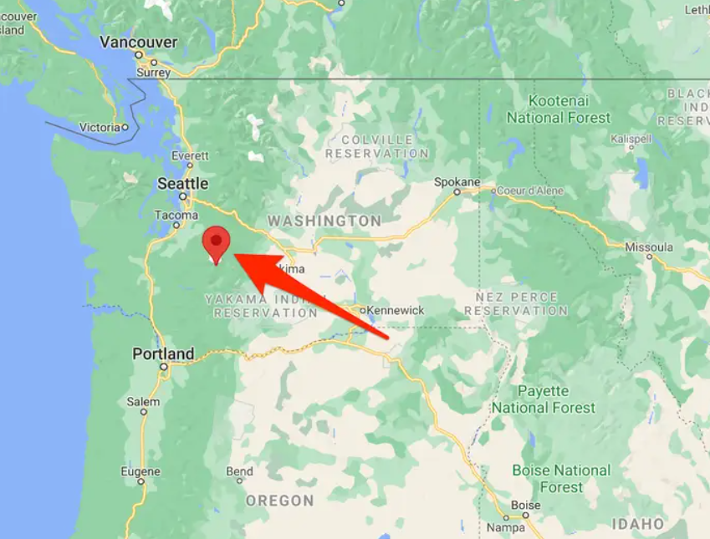
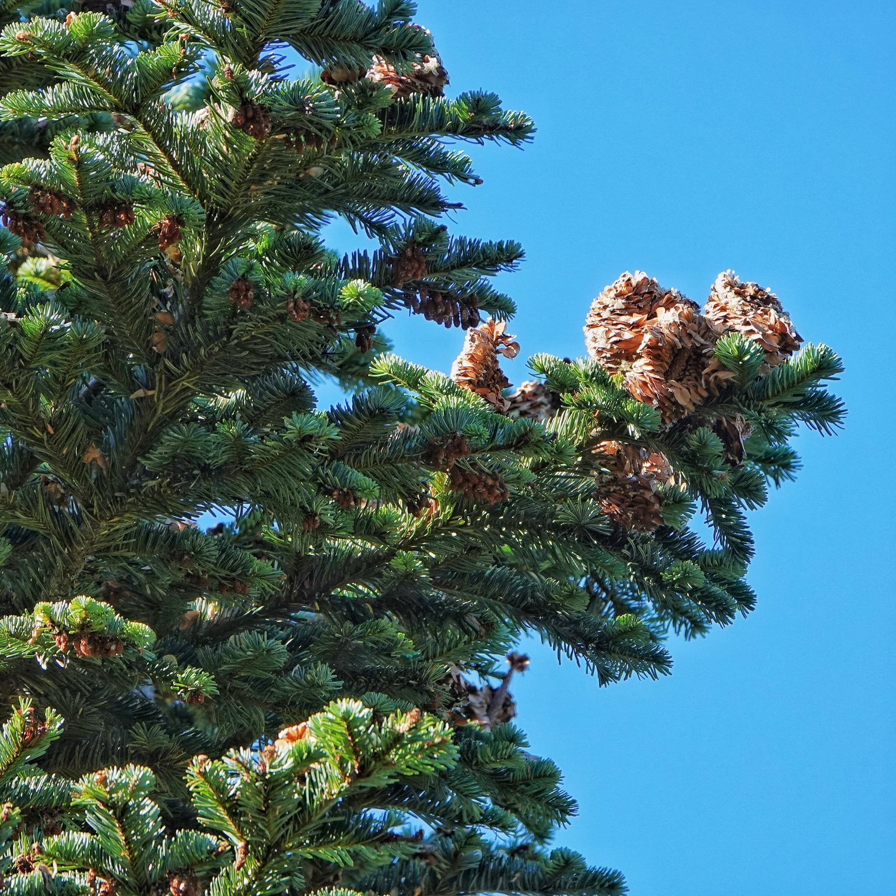
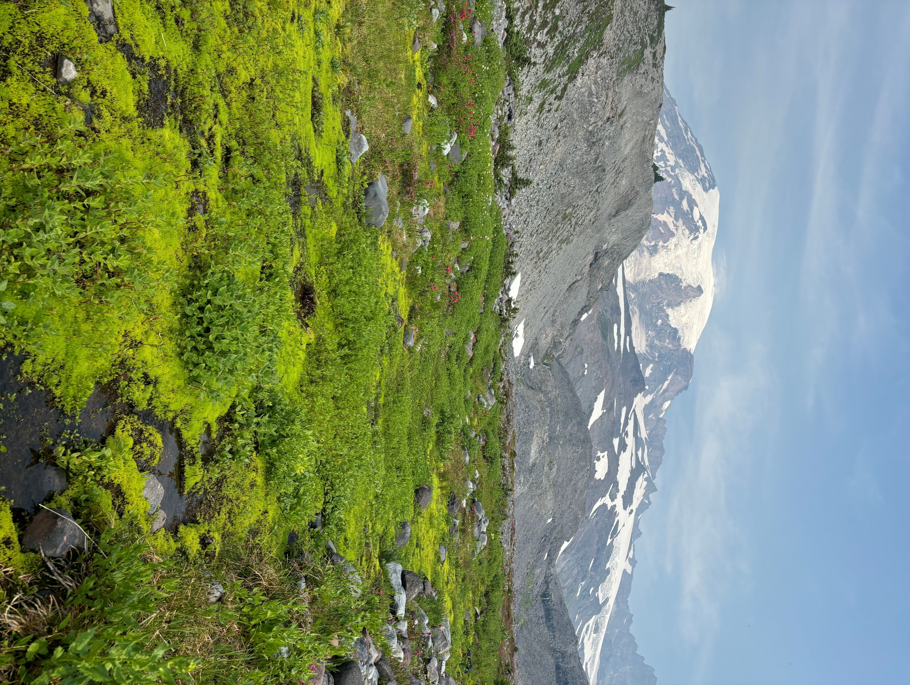
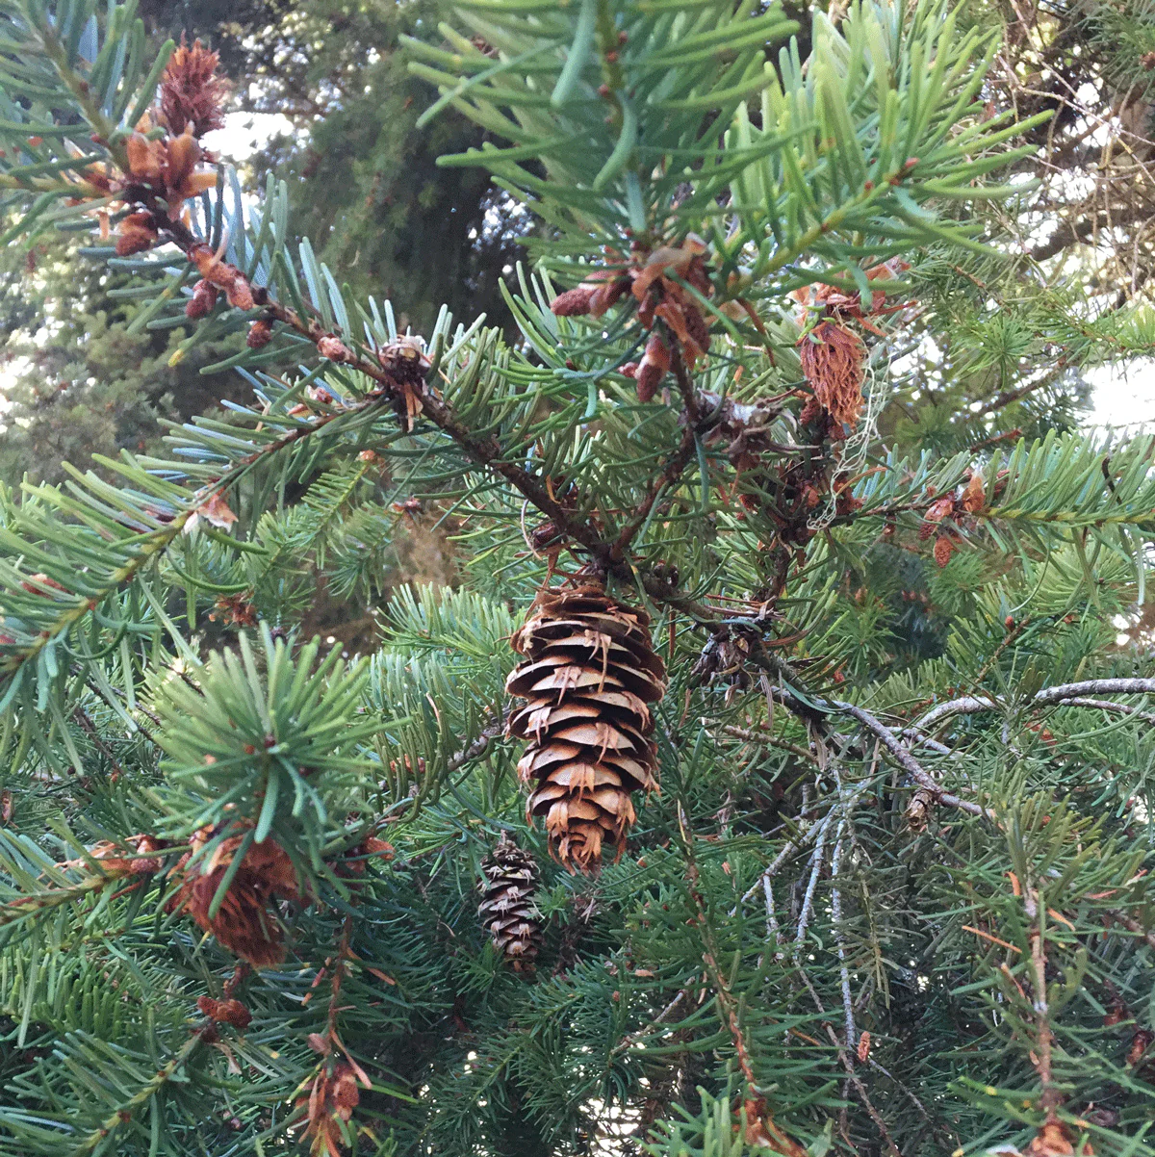
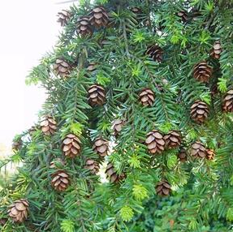
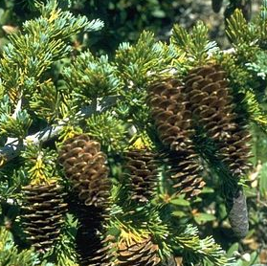
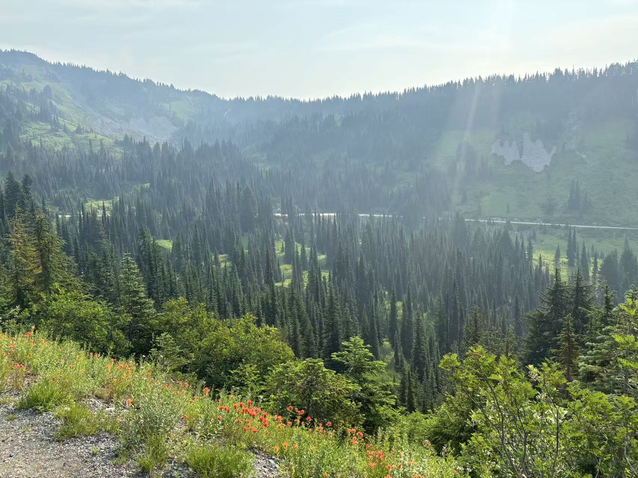
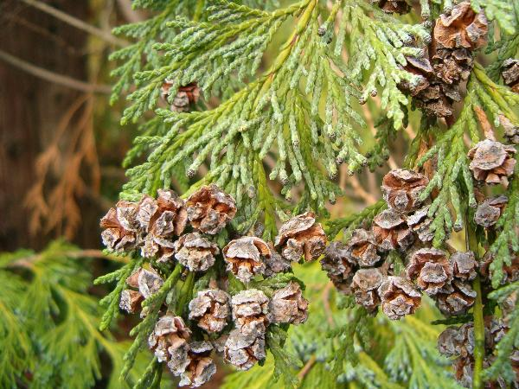
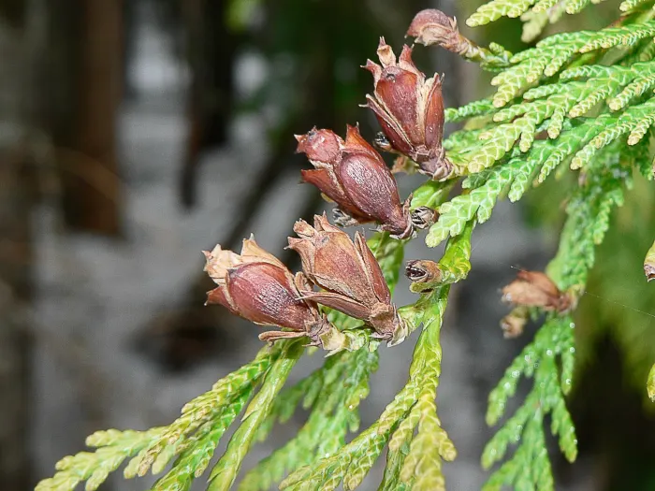
Abies amabilis
Pacific silver fir
Pseudotsuga menziesii
Douglas-fir
Tsuga heterophylla
Western hemlock
Tsuga mertensiana
Mountain hemlock
Callitropsis nootkatensis
Yellow cedar
Thuja plicata
Western Redcedar
Notes:
For my project, I’m investigating whether a growth–reproduction trade-off exists in several conifer species at Mount Rainier National Park.
These species differ in their reproductive cycles — most have two-year cycles, but a couple have more unique timelines.
This lets us test for trade-offs in the year before, during, and after mast years.

Slide 19
Source: iNaturalist
‘Flower’
development
Pollination
Fertilization
Maturation
Dispersal
Abies amabilis
Pacific silver fir
Fall
Winter
Spring
Summer
Fall
Winter
Spring
Summer
Fall
Pseudotsuga menziesii
Douglas-fir
Fall
Winter
Spring
Summer
Fall
Winter
Spring
Summer
Fall
Tsuga heterophylla
Western hemlock
Fall
Winter
Spring
Summer
Fall
Winter
Spring
Summer
Fall
Tsuga mertensiana
Mountain hemlock
Fall
Winter
Spring
Summer
Fall
Winter
Spring
Summer
Fall
Callitropsis nootkatensis
Yellow cedar
Fall
Winter
Spring
Summer
Fall
Winter
Spring
Summer
Fall
Thuja plicata
Western Redcedar
Fall
Winter
Spring
Summer
Fall
Winter
Spring
Summer
Fall
Notes:
For my project, I’m investigating whether a growth–reproduction trade-off exists in several conifer species at Mount Rainier National Park.
These species differ in their reproductive cycles — most have two-year cycles, but a couple have more unique timelines.
This lets us test for trade-offs in the year before, during, and after mast years.

Slide 20
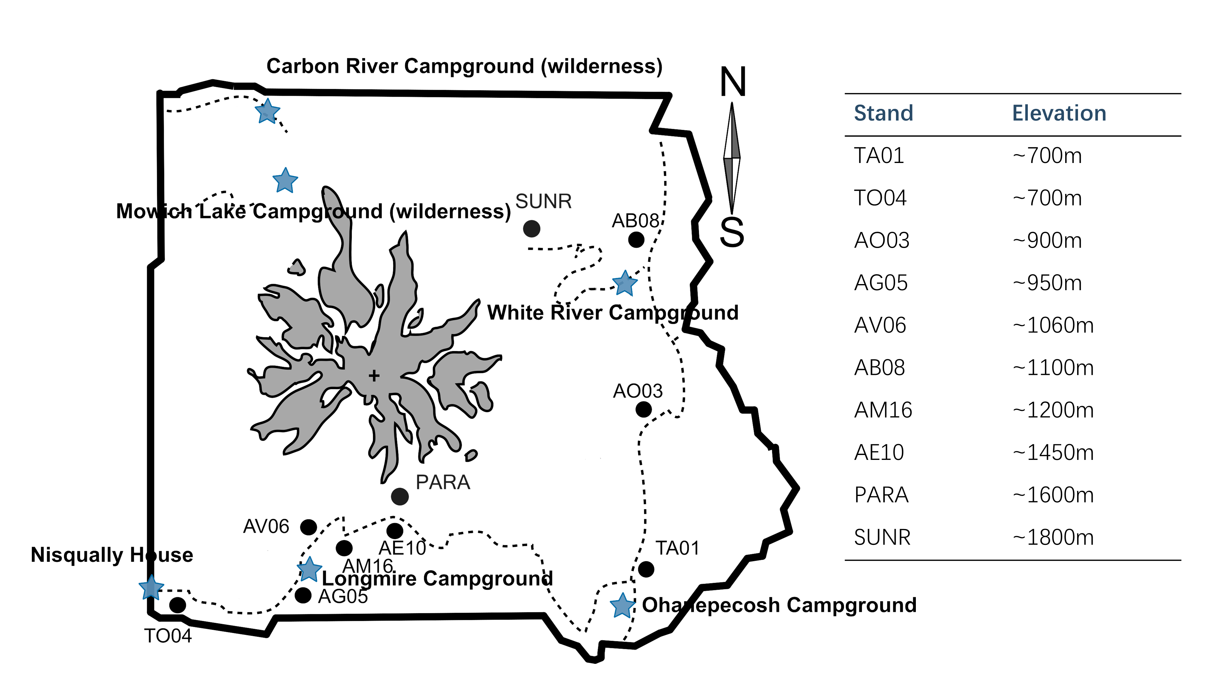
Different elevation indicating different resources availability, proxy of climate change
Notes:
Mount Rainier also offers a elevational gradient.
And among the species we have, some of them span wide ranges, while others are restricted to low or high elevations.
Elevation can serve as a proxy for resource availability and climate variation, giving us a way to test how reproductive strategies shift with changing environmental conditions.

Slide 21
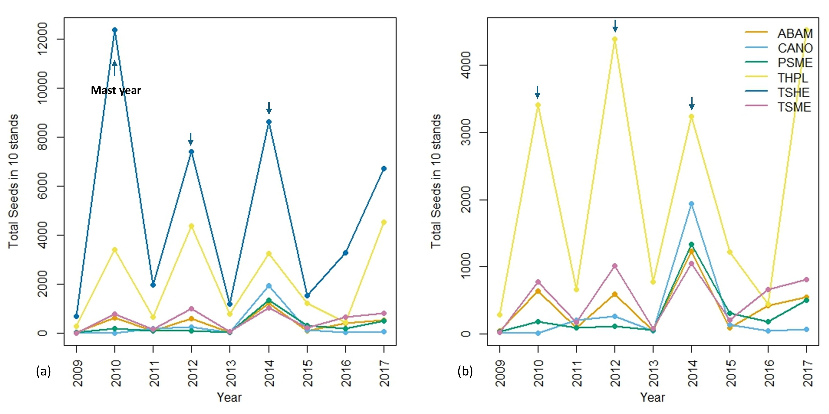
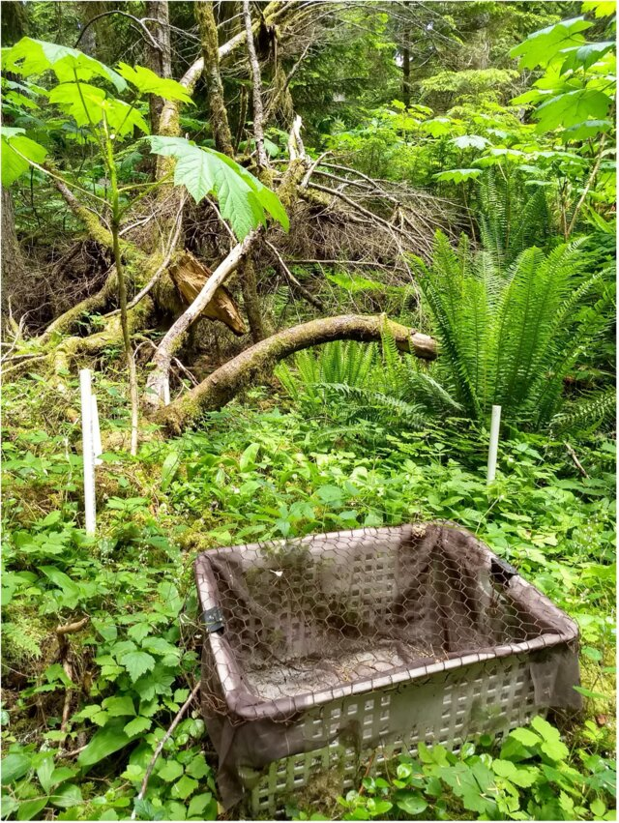
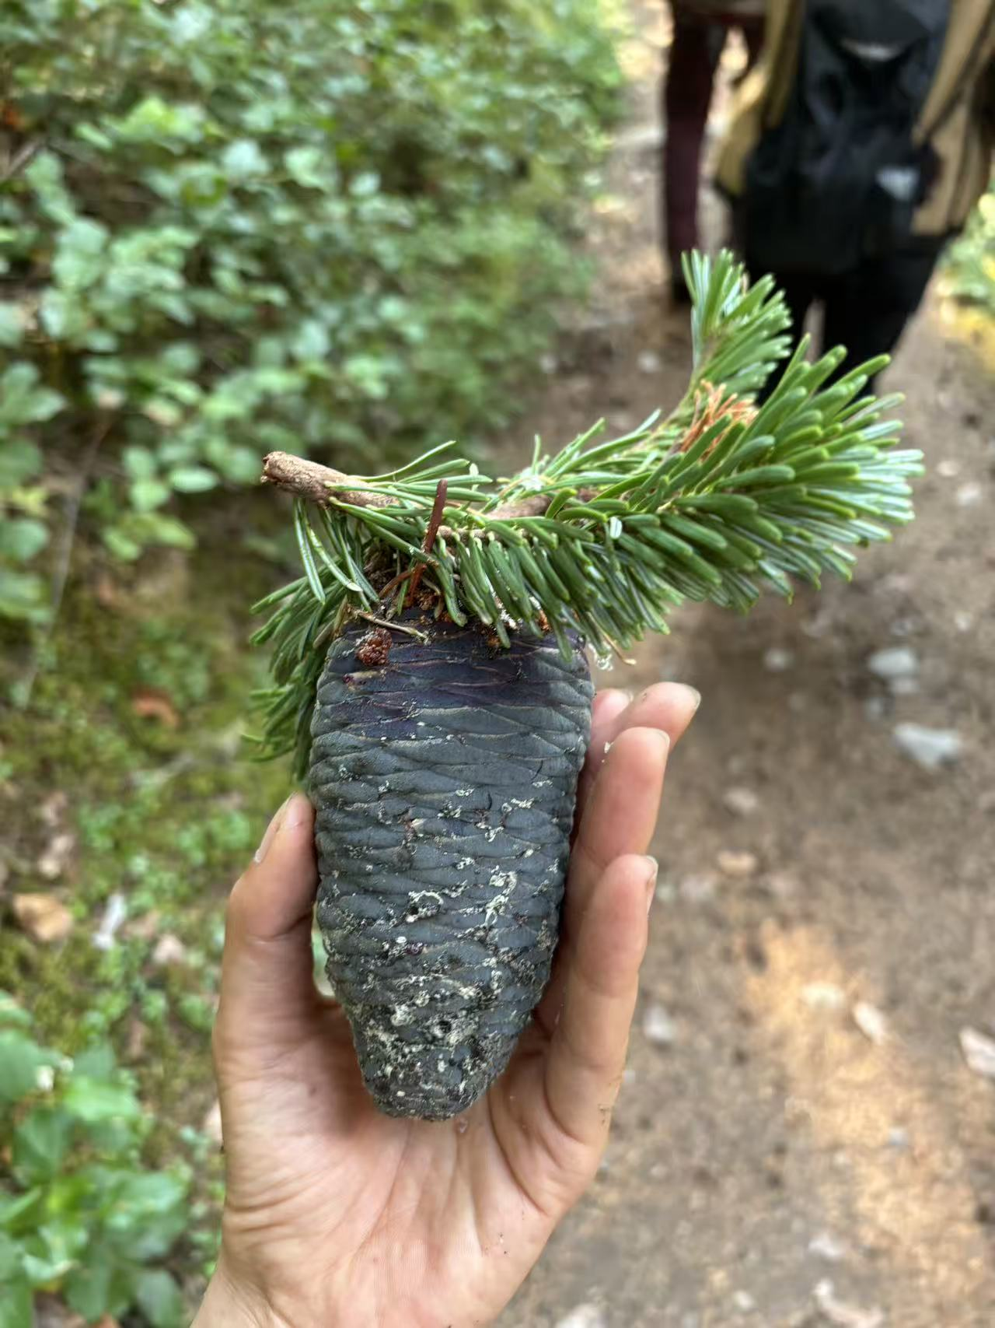
Notes:
For reproductive data, I’m using long-term seed trap data from Janneke’s lab.
Seed traps were placed across different forest stands to monitor annual seed production.
This kind of long-term dataset is incredibly valuable for studying masting patterns and linking them to both climate and growth. And we believe there’s enough variation in seed counts to identify mast years within the data.

Slide 22
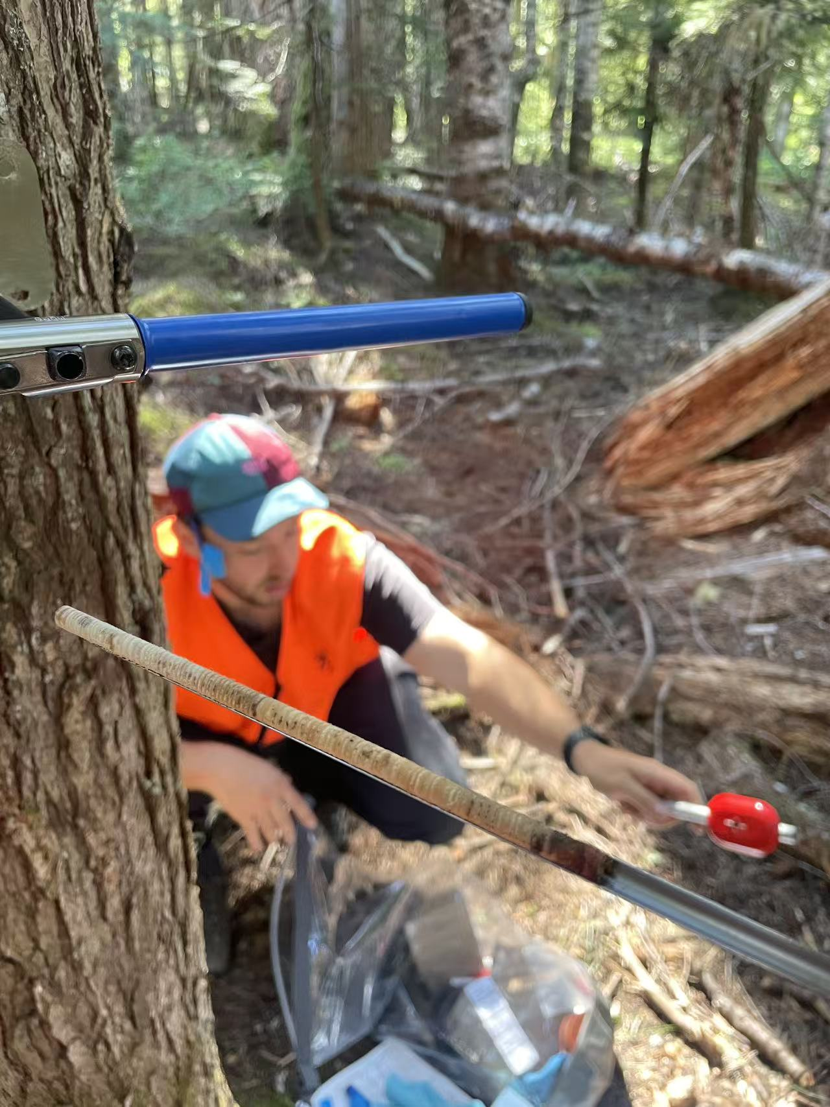
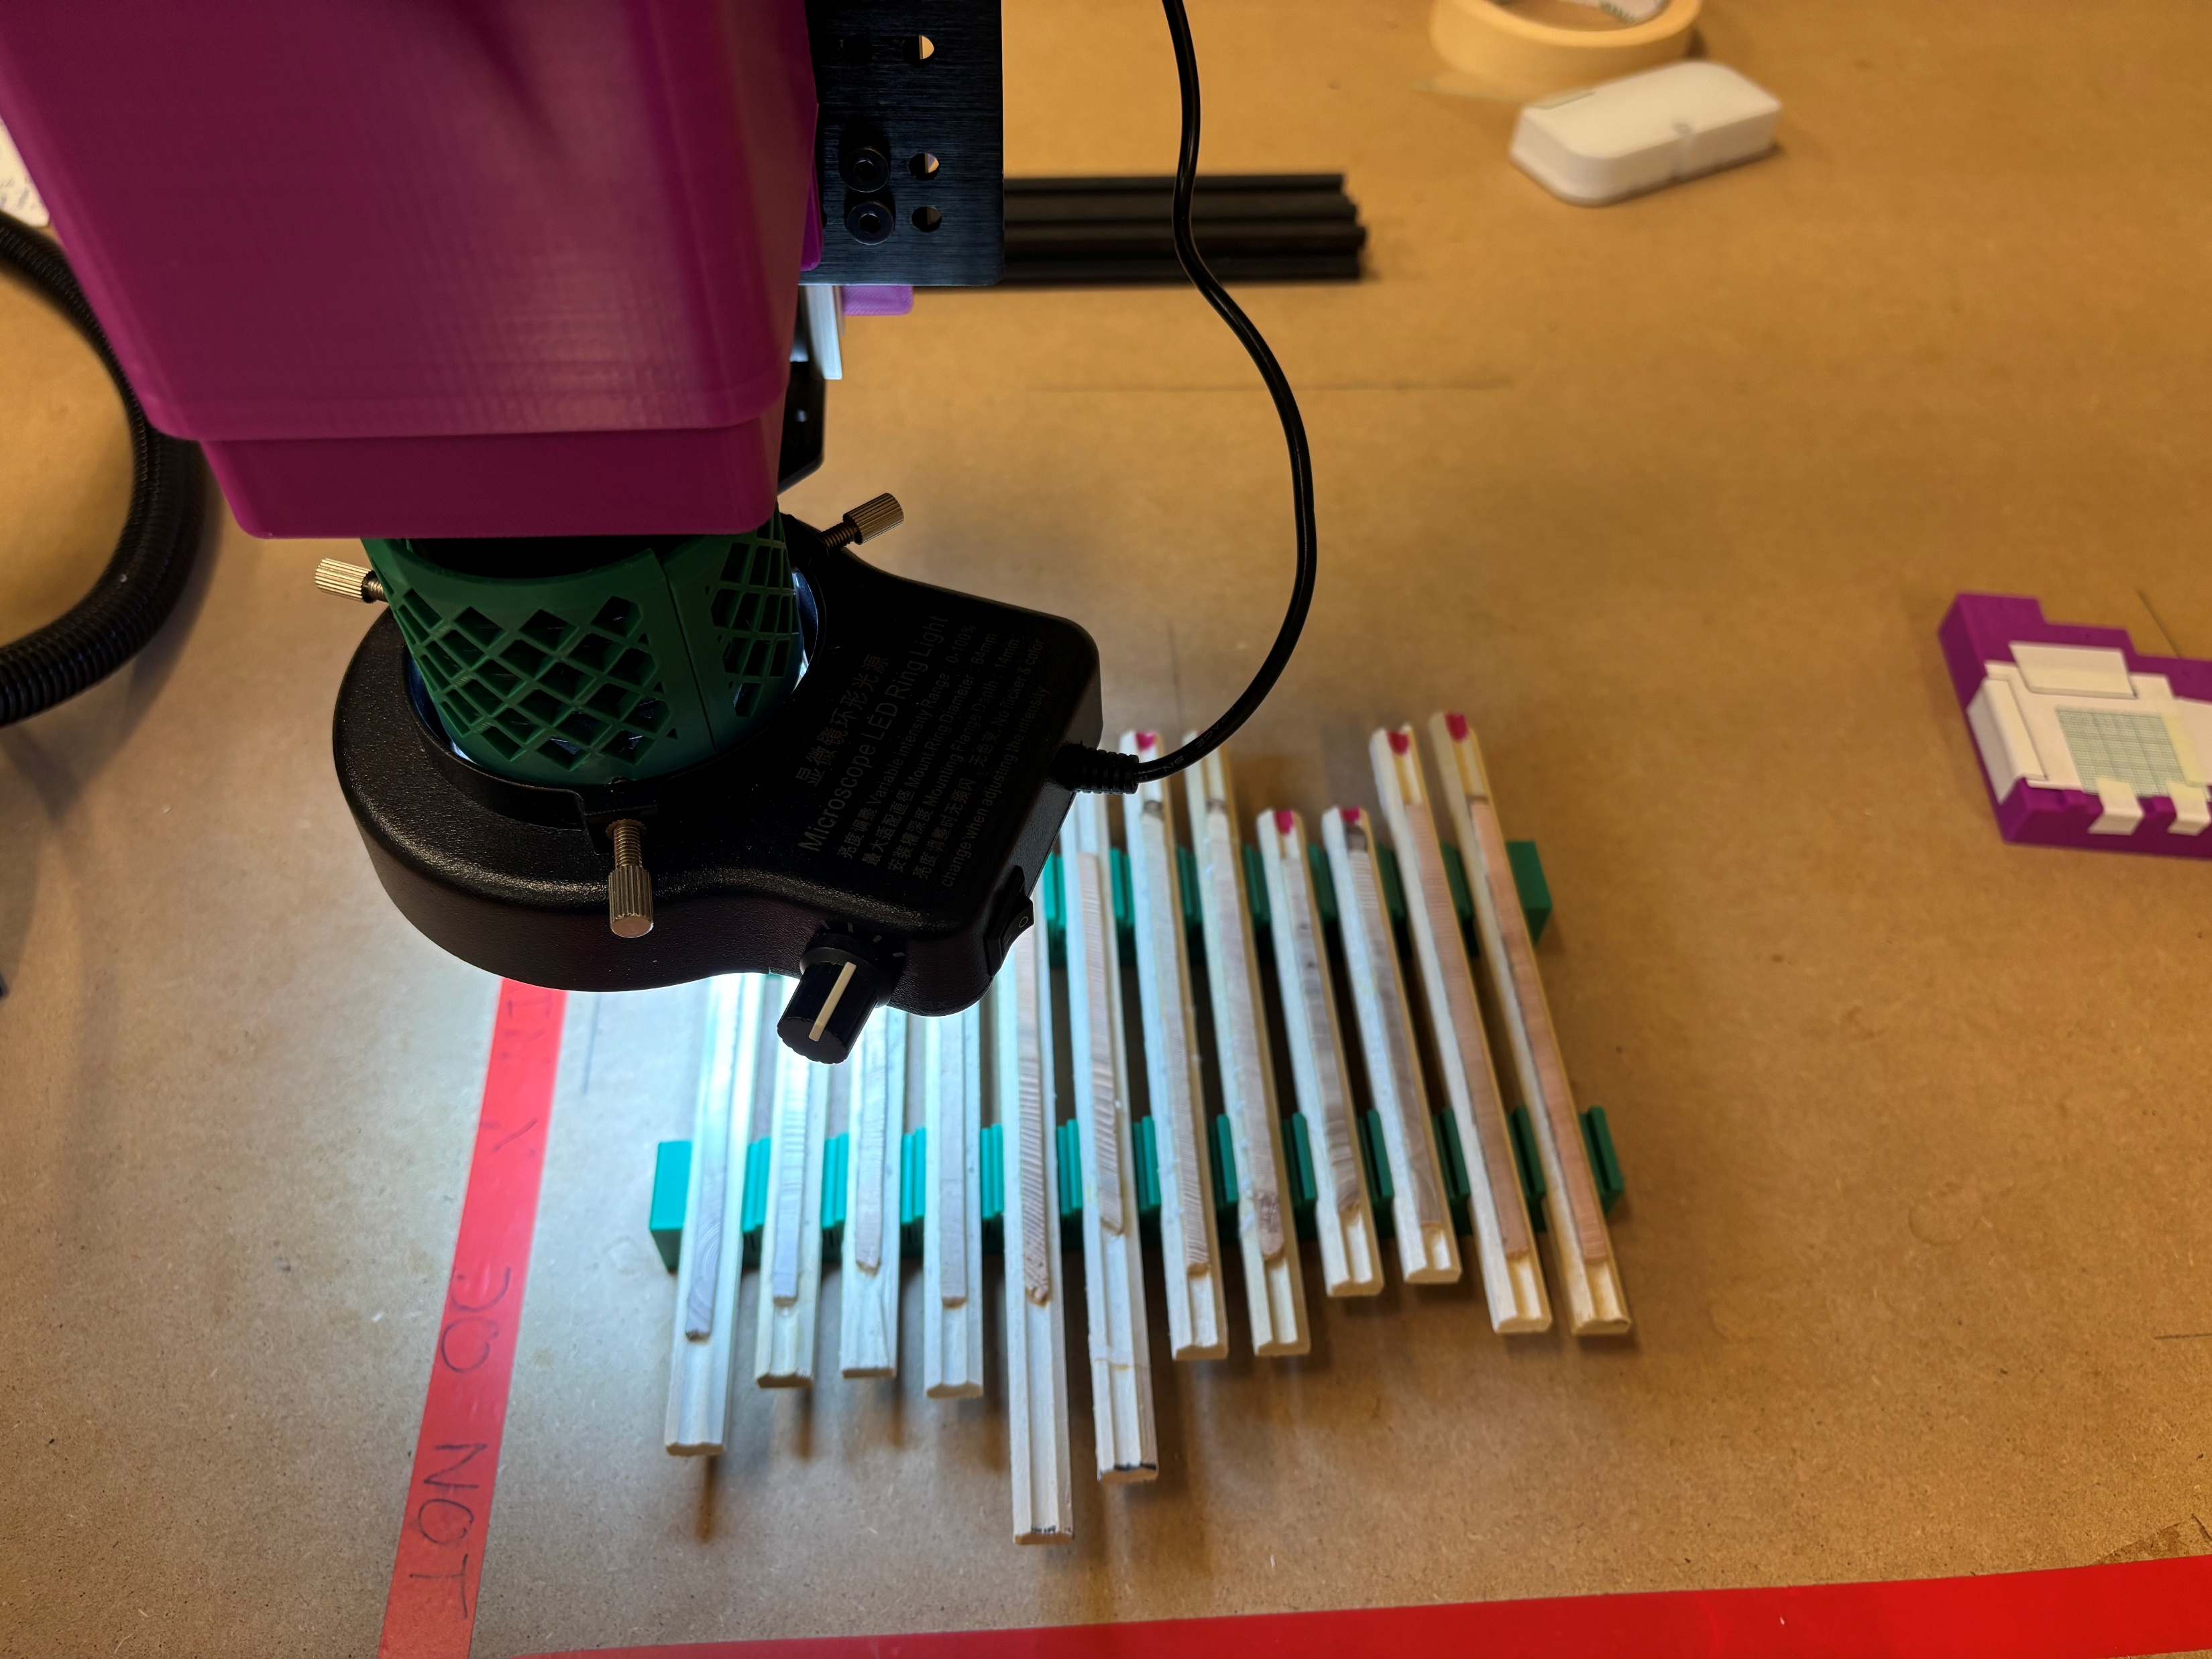
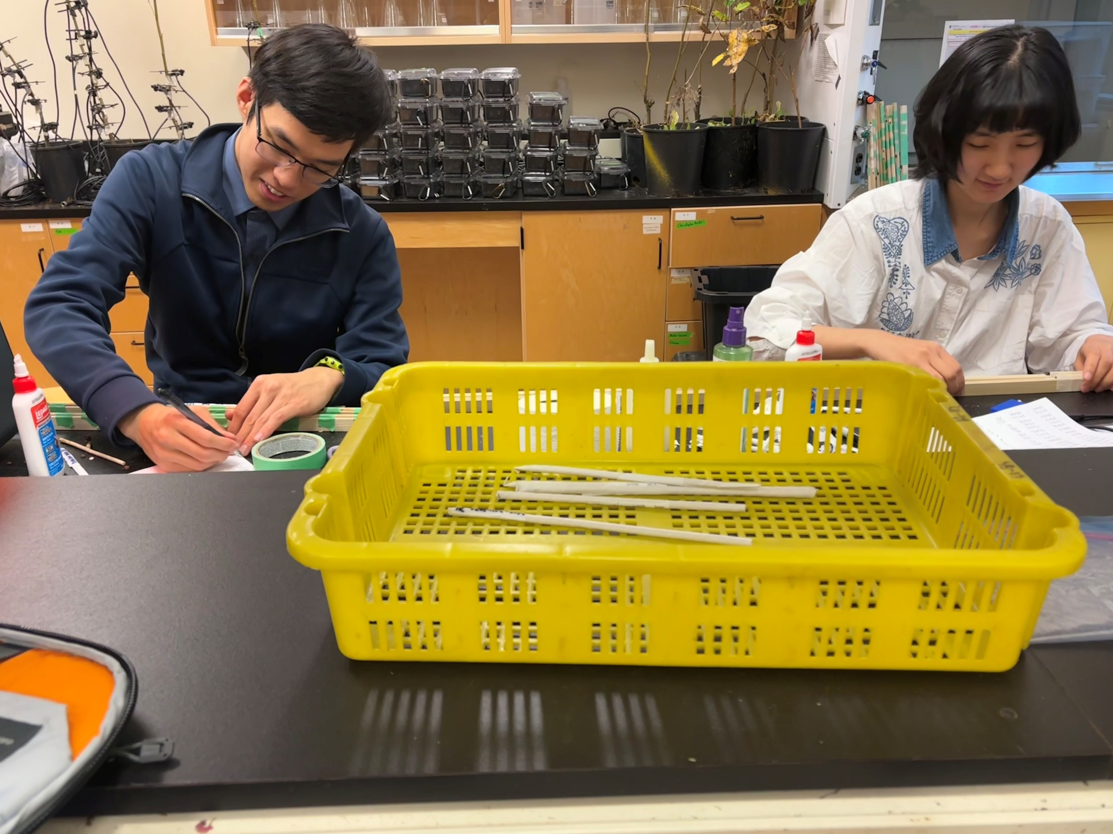



Coring Mounting Sanding Scanning Measuring Cross-dating Analyzing
Notes:
For the growth data, I’m using radial growth —how much the trees grow in diameter each year, since this might account for the most growth for adult conifer trees.
Last year we spent a mount at Mount Rainier, with help from an amazing field crew, we collected over 1,000 tree cores from different stands across elevations.
Processing them is a big job — I’m currently scanning them with a custom camera built by a former engineering student in our lab.
These cores will give us annual-resolution growth data to compare with seed production.

Slide 23
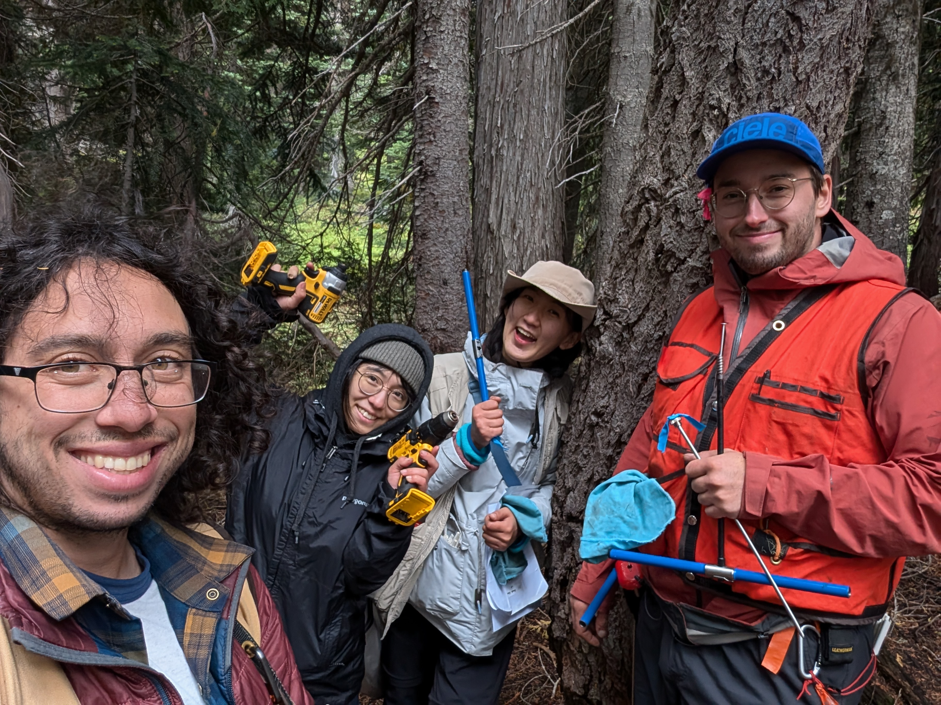

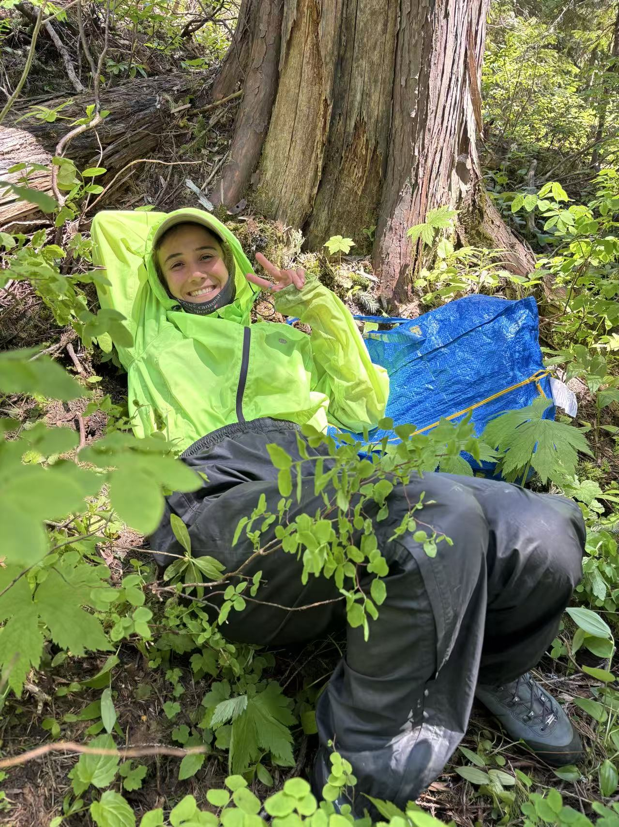



WorkLearn students: Qingyang Deng, Mark Pan, Colette Bennett, Tess Blajberg, Nolan Meier
Notes:
This project wouldn’t be possible without a lot of collaboration — from fieldwork to lab work to data sharing.
I’m incredibly grateful to be part of this team and to work in such a beautiful place.
I’m excited to see what patterns we might see as we analyze the data — and what that can tell us about how trees balance growth and reproduction in a changing climate.

Slide 24
Seed_{j,sp,y} ∼ NegBinomial(λ_{j,sp,y}, ϕ)
The modeled seed count (λ_{j,sp,y}) for stand j, species sp, and year y is:
log_{(λj,sp,y)} = α₀ + α_{sp} + α_{j} + β_{1,sp} ・ Growth_{j,sp,y} + β_{2,sp}・ Growth_{j,sp,y−1} + β_{3,sp} ・ Elevation_{j}

